Slide 1
Distributed Deadlock Detection
Y. V. Lokeswari
AP/ CSE
Reference: Advanced Concepts in OS
by
Mukesh Singhal & N.G. Shivaratri

Slide 2
Distributed Deadlock Detection
Obermarck’s Algorithm
&
Chandy, Misra and Haas Algorithm

Slide 3
Deadlock in the AND model; there is a cycle
but no knot No Deadlock in the OR model
Path-Pushing Algorithm (Obermarck’s Algorithm)
P1
P3
P2
P1->P2->P3
P1->P2->P3->P4->P5->P6->P8->P9->P1
S1
P1->P2->P3->P4->P5->P6
P6
P4
P8
P5
P9
P7
P10
P1->P2->P3->P4->P5->P7
S2
S3
P1->P2->P3->P4->P5->P7->P10

Slide 4
Deadlock in both the AND model and the OR model;
there are cycles and a knot
Path-Pushing Algorithm (Obermarck’s Algorithm)
P1
P3
P2
P1->P2->P3
P1->P2->P3->P4->P5->P6->P8->P9->P1
S1
P1->P2->P3->P4->P5->P6
P6
P4
P8
P5
P9
P7
P10
P1->P2->P3->P4->P5->P7
S2
S3
P1->P2->P3->P4->P5->P7->P10->P9

Slide 5
Drawbacks of Path-Pushing Algorithm
The algorithm detects Phantom deadlocks
The algorithm sends n(n-1)/2 messages to detect deadlock involving n sites.
Size of the message is O(n)
Delay in detecting deadlock is O(n)
Overhead in sending WFG information to each site via network.
By the time deadlock is declared, deadlock would have been resolved. (Phantom deadlocks).

Slide 6
Chandy Misra Haas’s Algorithm
Edge-Chasing Algorithm
Instead of sending the WFG from each site, this method sends a Probe message which has a fixed size.
Probe(i,j,k)

Slide 7
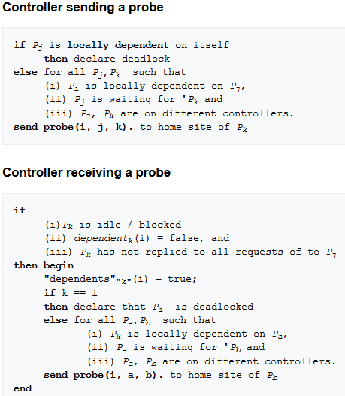
Chandy Misra Haas’s Algorithm
Edge-Chasing Algorithm

Slide 8
Deadlock in the AND model; there is a cycle
but no knot
No Deadlock in the OR model
Edge-Chasing Algorithm
P1
P3
P2
Probe(1,3,4)
Probe(1,9,1)
S1
Probe(1,6,8)
P6
P4
P8
P5
P9
P7
P10
Probe(1,7,10)
S2
S3

Slide 9
Deadlock in both the AND model and the OR model;
there are cycles and a knot
Edge-Chasing Algorithm
P1
P3
P2
Probe(1,3,4)
Probe(1,9,1)
S1
Probe(1,6,8)
P6
P4
P8
P5
P9
P7
P10
Probe(1,7,10)
S2
S3

Slide 10
Edge-Chasing Algorithm
The algorithm at most exchanges m(n-1)/2 messages to detect deadlock involving m processes and spans over n sites.
Size of the message is fixed. Only 3 integer values.
Delay in detecting deadlock is O(n)

Slide 11
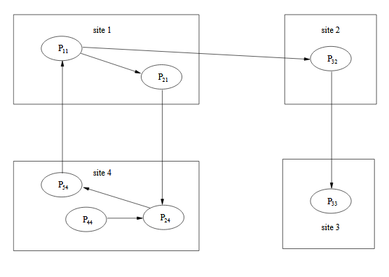
Workout Example

Slide 12
Other Deadlock detection Algorithms
Diffusion Computation Algorithm
Global State Detection based Algorithm

Slide 13
Thank You

